Slide 1

QUALITY CONTROL
OVERVIEW

Slide 2
PURPOSE
Understanding QC function
Various tests that are performed
Understanding the category of tests
Significance of/reason for performing the tests

Slide 3
What we do in Quality control
QC will receive the samples for the testing from various departments with the sample testing requests. upon receiving the requests QC will enter those in the respected LOGs and proceed for the
Testing of Packing materials
Testing of Raw materials- API
Testing of Raw materials- Excipients
Testing of Microbiological samples
Testing of In-process materials
Testing of Finished goods
Testing of Stability samples
Classification of tests-1.Identification tests 2.Tests for strength/content
3.purity(control of impurities) 4.Functionality tests.

Slide 4
Identification tests
These tests are designed to verify the identity of the material. e.g. chemical structure, optical isomer, crystal form, salt etc.
At least two tests based on different analytical techniques are required to be part of specification.
Identification of each container is often performed to rule out mix-up (Rapid techniques like NIR or Raman spectroscopy are often used for such 100% ID.)

Slide 5
Tests for strength /content
The test is commonly called as Assay and is designed to establish the strength or the purity of the material.
Primary methods like Titrimetry or secondary methods like HPLC,GC etc.are used to determine the Assay.
Limits are defined based on the variability expected in the material and analytical variability.
Assay is often expressed on anhydrous basis. In such cases determination of water content or Loss on drying is performed on the sample and the result is used to express the assay on anhydrous tests.

Slide 6
Purity(Control of Impurities)
While Assay gives idea about gross purity of the material,it is important to ensure that the material is free from unwanted impurities which can come from the source or the process.
These tests are designed to detect and quantify the impurities which are likely to be present in the material.
The impurities can include-
1.chemical impurities coming from the starting materials or formed
during the manufacturing process.
2.Residual solvents, unwanted isomers, Metallic impurities which
may come from the catalysts or from the equipment.
3.Microbial contamination.

Slide 7
Functionality/Efficacy tests
Apart from the chemical purity some materials have to have other specific characteristics to produce desired effect.
Functionality tests are designed to evaluate such characteristics.
These tests are include but not limited to
Particle size distribution
Bulk density
Polymorphism
viscosity
Solubility
pH

Slide 8
Chromatography(Meaning and principle)
Chromatography is derived from kromatos- colour and graphos-written.
Chromatography is classified into
1.Gas chromatography (GLC & GSC)
2.Liquid chromatography(LLC &LSC)
Separation of substances at molecular levels.
This is achieved using attraction or repulsion of the phases to be separated towards the stationary phase.
Mobile phase-gas or liquid
Stationary phase-liquid or solid.

Slide 9
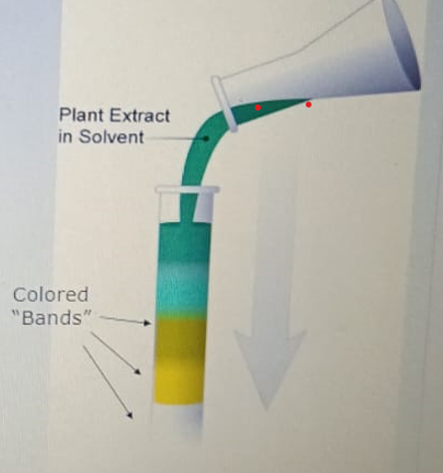
Tswetts Equipment Origin of chromatography
Tall glass open filled with silica gel.
Ground-up plant extracts
Poured into the column and saw colored “Bands”
Chroma- colour
Graphy – writing/study of

Slide 10
THANK YOU

